Slide 1


Future of Innovation in Medicaid:
Key Findings from Annual Medicaid MCO Survey + Innovation During the Pandemic National Environmental Scan
Jennifer E. Moore, PhD, RN, FAAN
September 15, 2022
Council for State Governments
www.MedicaidInnovation.org | @Innov8Medicaid

Slide 2
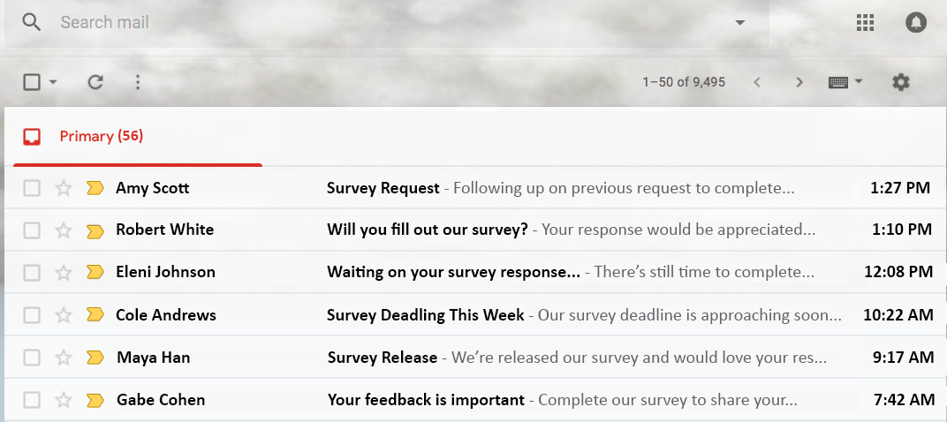

Slide 3



55% of Americans think they are smarter than the average American,
34% feel they are average, and 4% feel they are below average
34%
4%
55%

Slide 4



25% of Americans think the sun revolves around the Earth
75%
25%

Slide 5


27% identify a Gigabyte as an insect commonly found in South America
73%
27%

Slide 6

75% of people believe polls and survey results are biased
25%
75%

Slide 7
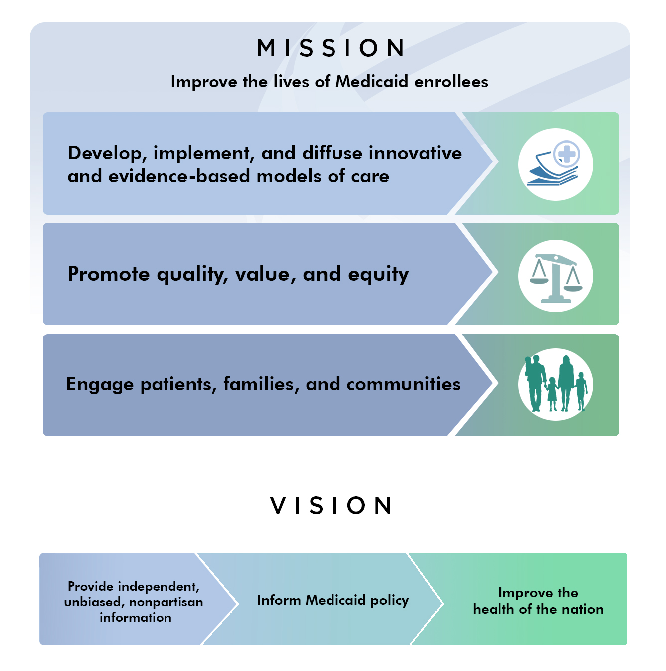

www.MedicaidInnovation.org | @Innov8Medicaid

Slide 8
Emerging Topics
Women and Gender Health
Behavioral
Health
Policy Analysis
Convening Meetings
Dissemination of Evidence and Best Practices
Qualitative & Quantitative Research
Collaborative Learning
Best
Practices
Knowledge Development
IMI Strategic Priorities
Annual Survey
Multi-Stakeholder Engagement
Facilitate Collaboration & Partnerships
Toolkits
Technical Assistance
Highlight Innovative Solutions
Child
Health
State Facts
Disparities
& Equity
www.MedicaidInnovation.org | @Innov8Medicaid

Slide 9








IMI Strategic Priorities
Access, Coverage, and Outcomes
Community
and Equity
Data and Quality
Sustainability
www.MedicaidInnovation.org | @Innov8Medicaid

Slide 10

www.MedicaidInnovation.org | @Innov8Medicaid

Slide 11


Identifying Trends Over Time
| Background & Purpose
2016
2017
2018
2019
2020
2021
2022
Work began to develop the survey
Survey first piloted
First official survey release and report
Current survey release
www.MedicaidInnovation.org | @Innov8Medicaid

Slide 12
A Comprehensive Snapshot
| Background & Purpose
Lives Covered by Medicaid
67% of individuals covered by Medicaid
37 states
www.MedicaidInnovation.org | @Innov8Medicaid

Slide 13
A Comprehensive Look
| Background & Purpose
Health Plan Structure
  55% private, non-profit
  25% private, for-profit
  20% public or government
Health Plan Size
  50% small
  15% medium
  35% large
www.MedicaidInnovation.org | @Innov8Medicaid

Slide 14
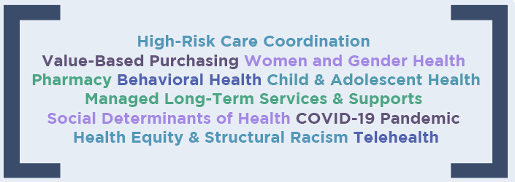
A Roadmap for Innovation
| Background & Purpose
11 Health Domains
www.MedicaidInnovation.org | @Innov8Medicaid

Slide 15
Pivoting to Address the Pandemic
| Strengths of Medicaid Health Plans
5%
15%
30%
70%
95%
85%
www.MedicaidInnovation.org | @Innov8Medicaid

Slide 16
Prioritizing Equity
| Strengths of Medicaid Health Plans
Medicaid created to serve populations at-risk for health disparities
Health plans have taken concrete action:
  70% had a health equity plan
  100% of those implemented supporting programs
  53% had a chief equity officer or similar position
  33% worked with Small Disadvantaged Businesses and Small and Diverse Businesses
www.MedicaidInnovation.org | @Innov8Medicaid

Slide 17





Addressing Social Needs
| Strengths of Medicaid Health Plans
5%
Housing
(100%)
Nutrition/ Food Security
(100%)
Social Isolation
(95%)
95%
Non-Emergency Medical Transportation
(95%)
Employment
(90%)
Application Assistance
(90%)
www.MedicaidInnovation.org | @Innov8Medicaid

Slide 18
Engaging Communities
| Strengths of Medicaid Health Plans
These needs are addressed by…
10%
5%
95%
90%
90%
95%
79%
79%
www.MedicaidInnovation.org | @Innov8Medicaid

Slide 19
Policy Change Needed to Maintain Pandemic Gains
| Challenges Facing Medicaid Health Plans
Traditional funding structures do not necessarily support new initiatives, like:
  Telehealth
  Social needs programming
Reimbursement policies need to be updated.
www.MedicaidInnovation.org | @Innov8Medicaid

Slide 20
Communication Challenges Inhibit Progress
| Challenges Facing Medicaid Health Plans
Ability to Contact Members
Health Screening Tools
Members’ Willingness to Engage
Communication
Children with
Special Healthcare Needs
Data Sharing with Care Managers
Substance Use Treatment Information
www.MedicaidInnovation.org | @Innov8Medicaid

Slide 21





Barriers to Telehealth
| Challenges Facing Medicaid Health Plans
For Enrollees:
For Health Plans:
  Limited access to technology, a private space, and equipment for in-home care
  Limited provider familiarity
  with telehealth platforms
  Low health literacy
  Lack of trust in healthcare
  Inconsistent policies
www.MedicaidInnovation.org | @Innov8Medicaid

Slide 22
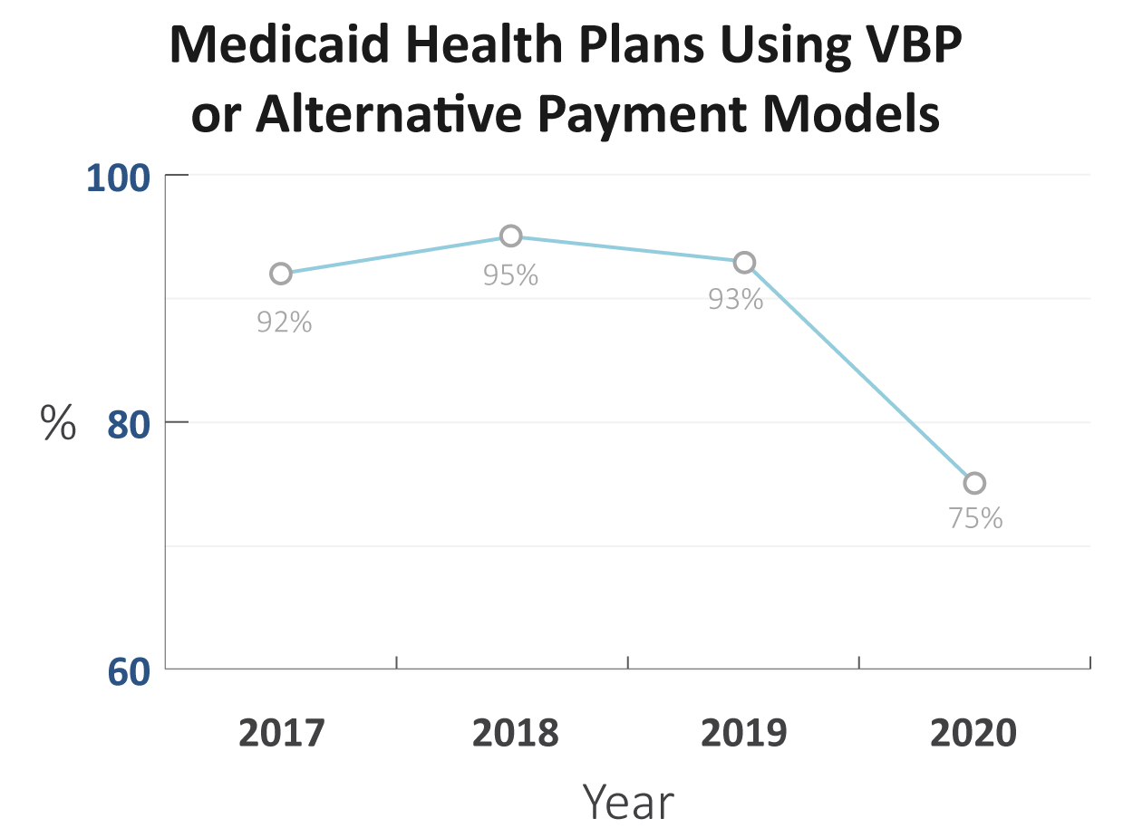
Unaddressed Barriers Threaten Value-Based Purchasing Long-Term
| Challenges Facing Medicaid Health Plans
www.MedicaidInnovation.org | @Innov8Medicaid

Slide 23
Value-Based Purchasing
| Providing Value for the Medicaid Program
Frequently used payment strategies:
56%
78%
10%
90%
56%
www.MedicaidInnovation.org | @Innov8Medicaid

Slide 24
Maternal Mortality
| Challenges Facing Medicaid Health Plans
How are Medicaid Health Plans Responding?
U.S. maternal mortality rate: 17.2 deaths per 100,000 live births
  Black women are 3 – 4x more likely to die during pregnancy or childbirth than their white counterparts
79%
63%
58%
www.MedicaidInnovation.org | @Innov8Medicaid

Slide 25
Pharmacy
| Challenges Facing Medicaid Health Plans
Common Barriers:
75%
69%
20%
80%
Innovations:
81%
79%
www.MedicaidInnovation.org | @Innov8Medicaid

Slide 26
Managed Long-Term Services and Supports (MLTSS)
| Challenges Facing Medicaid Health Plans
Barriers:
40%
50%
42%
42%
75%
60%
Of those, 58% used a different clinical model of care for MLTSS programs than in general Medicaid managed care contracts.
www.MedicaidInnovation.org | @Innov8Medicaid

Slide 27
Looking to the Future
| Challenges Facing Medicaid Health Plans
Traditional funding structures do not necessarily support new initiatives, like:
  Telehealth
  Social needs programming
Reimbursement policies need to be updated.
Policy change needed
  Shift funding structures
  Strengthen communications
  Address barriers to VBP
Areas for continued analysis
  Impact of COVID-19
  Transition to telehealth
  Long-term equity and social needs trends
www.MedicaidInnovation.org | @Innov8Medicaid

Slide 28
Medicaid Managed Care’s Pandemic Pivot:
Addressing Social Determinants of Health to Improve Health Equity

Slide 29



Medicaid Managed Care’s Pandemic Pivot
www.MedicaidInnovation.org | @Innov8Medicaid

Slide 30


Medicaid Managed Care’s Pandemic Pivot
Emerging Best Practice Categories
Response and Vaccine Initiatives (7)
Health Care Access & Improvement Initiatives (8)
Food & Housing Access (4)
Maternal & Child Health (3)
Community & Wellness Resources (3)
www.MedicaidInnovation.org | @Innov8Medicaid

Slide 31


Medicaid Managed Care’s Pandemic Pivot
Overall Themes
New Priorities
Shifted the Location of Health and Social Services
Partnerships
Rapid Response
Commitment to Sustainability
www.MedicaidInnovation.org | @Innov8Medicaid

Slide 32

Medicaid Managed Care’s Pandemic Pivot
Lessons Learned
Managed Care Can Facilitate Innovation
Value of Longstanding Investments
Importance of Continuous Enrollment
Telehealth Flexibilities Support Access
Flexibilities at the State Level
www.MedicaidInnovation.org | @Innov8Medicaid

Slide 33








Medicaid Managed Care’s Pandemic Pivot
Innovative Initiatives – Case Studies
COVID-19 Response Plan | Aetna Better Health of Texas
Flexible Housing Pool | CountyCare Health Plan
Enhancing Maternal Health by Addressing Social Isolation | Parkland Community Health Plan
Federally Qualified Health Centers (FQHC) Transformation Investment Program | UnitedHealthcare Community & State
Freedom House 2.0 | UPMC Health Plan
Healthy U Behavioral Hub | University of Utah Health Plans
Mana Mama | AlohaCare
Safety Testing Overall Partnership (S.T.O.P.) COVID-19 Disparities | UnitedHealthcare Community & State
www.MedicaidInnovation.org | @Innov8Medicaid

Slide 34
Featured Initiatives and Panelists
Medicaid Managed Care’s Pandemic Pivot

Slide 35

COVID-19 Response Plan
Aetna Better Health of Texas
Objectives
Raise awareness and provide education on COVID-19 vaccines;
Provide members with a single source for all COVID-19 information and vaccine related incentives;
Increase COVID-19 vaccination rates for Aetna members, addressing barriers such as location, transportation, and hesitancy
Meet medical and non-medical needs.
Impact
Reached over 22,000 people and educated almost 12,000 members
Conducted more than 12,00 searches in for social services and resources from April 2020 through March 2022; over 18 percent of searches were for food resources.
The equivalent of 7.1 million meals in funds to Texas foodbanks, 2.8 million of which reached communities of color and rural communities.
www.MedicaidInnovation.org | @Innov8Medicaid
Notes:
4 of these

Slide 36

Mana Mama
AlohaCare
Objectives
Mana Mama’s overall goals are to reduce disparities in outcomes such as preterm delivery and maternal/infant mortality and to lower costs related to birth and neonatal intensive care. Other objectives are to increase:
• Timely prenatal/postpartum visits;
• Perinatal depression screenings and follow-up;
• Vaccination in pregnant/postpartum members and their families; and
• Screening for social determinants of health and connecting families to social services.
Impact
Since July 2021, Mana Mama outcomes include:
• 848 percent increase in calls and 606 percent increase in clients;
• 729 clinical visits conducted (health screenings, mental health services, prenatal/postpartum visits, lactation consultations, reproductive/family planning visits, COVID-19 testing);
• 1,348 COVID-19 vaccinations administered;
• 185 clients engaged on the 24-Hour telehealth platform;
• 100 community-based doula birth and/or postpartum services; and
• 548 households received rental assistance, partnered with Catholic Charities Hawai‘i
www.MedicaidInnovation.org | @Innov8Medicaid

Slide 37

Freedom House 2.0
UPMC for You
Objectives
To create an equitable model for employment opportunities and a new generation of emergency responders who could also address critical psychosocial needs, the initiative sought to:
• Provide emergency first responder career training.
• Provide job placement support to individuals experiencing health and economic disparities.
• Expand the pandemic workforce.
Impact
As of June 2022, Freedom House 2.0’s outcomes have been:
• 21 students graduated from the program;
• 85 percent employment rate for graduates;
• Graduates make an average of $15.60/hour (minimum wage in Pennsylvania is $7.25/hour);
• 15 BIPOC (Black, Indigenous, and People of Color) students have graduated from the program; and
• 10 graduates are employed by or were offered employment by UPMC.
www.MedicaidInnovation.org | @Innov8Medicaid

Slide 38

Medicaid Managed Care’s Pandemic Pivot
www.MedicaidInnovation.org

Slide 39




Learn more about IMI
Download resources at www.MedicaidInnovation.org
Follow us on social media
Follow us on Twitter at @Innov8Medicaid and on Facebook and LinkedIn
Subscribe to our newsletter
Subscribe on our website at www.MedicaidInnovation.org/news/newsletters
39
www.MedicaidInnovation.org | @Innov8Medicaid

Slide 40

Thank you!
www.MedicaidInnovation.org | @Innov8Medicaid

