Slide 1
Health and Health Care Disparities and the Role of Medicaid in Advancing Equity
Samantha Artiga
Vice President and Director, Racial Equity and Health Policy

Slide 2
What are health and health care disparities?
Disparities refer to differences in health and health care between groups
Higher burden of illness, injury, disability, or mortality
Differences in insurance coverage, access to and use of care, and quality of care
Closely linked with social, economic, and environmental inequities
Adversely affect groups who have systematically experienced greater obstacles to health
Racism results in conditions that unfairly advantage some and disadvantage others, placing people of color at greater risk for poor health outcomes
Health equity refers to attainment of the highest level of health for all people (Healthy People 2030)

Slide 3
People of color face longstanding disparities in health and health care.
Number of measures of health and health care for which group fared better, the same, or worse compared to White counterparts:
Note: AIAN is American Indian or Alaska Native; NHOPI is Native Hawaiian or Other Pacific Islander. Measures are for the most recent year for which data are available. "Better" or "Worse" indicates a statistically significant difference from White people at the p<0.05 level. No difference indicates no statistically significant difference. "Data limitation" indicates no separate data for a racial/ethnic group, insufficient data for a reliable estimate, or comparisons not possible due to overlapping samples. Persons of Hispanic origin may be of any race but are categorized as Hispanic for this analysis; other groups are non-Hispanic.
Source: Key Facts on Health and Health Care by Race and Ethnicity, KFF January 2022

Slide 4
Health disparities are driven by factors inside and beyond the health care system.
Economic Stability | Neighborhood and Physical Environment | Education | Food | Community, Safety, & Social Context | Health Care System
Racism and Discrimination
Employment Income Expenses Debt Medical bills Support | Housing Transportation Parks Playgrounds Walkability Zip code/ geography | Literacy Language Early childhood education Vocational training Higher education | Food security Access to healthy options | Social integration Support systems Community engagement Stress Exposure to violence/trauma Policing/justice policy | Health coverage Provider & pharmacy availability Access to linguistically and culturally appropriate & respectful care Quality of care
Health and Well-Being:
Mortality, Morbidity, Life Expectancy, Health Care Expenditures, Health Status, Functional Limitations

Slide 5
Addressing disparities is important for social justice and the nation’s overall health and economic prosperity.
Disparities result in unnecessary health care costs and limit the overall health and productivity of the nation
As the population becomes more diverse it is increasingly important to address disparities
Addressing the disparate impacts of COVID-19 is important for preventing against further widening of health disparities
Now is a pivotal time for translating attention to disparities into action to advance equity
Medicaid can serve as a key driver of health equity, but disparities remain for people in Medicaid and CHIP

Slide 6
The ACA coverage expansions helped narrow gaps in health coverage for people of color, but disparities persist.
Uninsured Rates for the Nonelderly Population by Race and Ethnicity, 2010-2019
AIAN
Hispanic
NHOPI
Black
White
Asian
NOTE: Includes individuals ages 0 to 64. AIAN refers to American Indians and Alaska Natives, NHOPI refers to Native Hawaiians and Other Pacific Islanders. Persons of Hispanic origin may be of any race but are categorized as Hispanic for this analysis; other groups are non-Hispanic
SOURCE: KFF analysis of the 2010-2019 American Community Survey.

Slide 7
Medicaid plays a disproportionately large role for people of color.
Health Coverage of the Nonelderly Population by Race and Ethnicity, 2020
NOTE: Includes individuals ages 0 to 64. Persons of Hispanic origin may be of any race but are categorized as Hispanic for this analysis; other groups are non-Hispanic. Other public coverage includes Medicare (excluding Part A only) and military coverage. Totals may not sum to 100 percent due to rounding.
SOURCE: KFF estimates based on the Census Bureau's March Current Population Survey (CPS: Annual Social and Economic Supplements), 2021.

Slide 8
Medicaid plays an even larger role for children of color.
Health Coverage of Children by Race and Ethnicity, 2020
NOTE: *Uninsured rate for Native Hawaiian and Other Pacific Islander children is not reported because it has a relative standard error above 30%.
Includes children ages 0 to 18. Persons of Hispanic origin may be of any race but are categorized as Hispanic for this analysis; other groups are non-Hispanic. Other public coverage includes Medicare (excluding Part A only) and military coverage. Totals may not sum to 100 percent due to rounding.
SOURCE: KFF estimates based on the Census Bureau's March Current Population Survey (CPS: Annual Social and Economic Supplements), 2021.

Slide 9
Studies generally find positive effects of the ACA Medicaid expansion across a range of outcomes.
Number of studies that find positive effects, no difference or mixed findings, and negative effects:
NOTES: Studies may have findings on multiple outcomes and be counted in multiple bars. “Insurance Coverage” includes coverage rates generally and for Medicaid.
SOURCE: KFF analysis of 601 studies of the impact of state Medicaid expansion published between January 2014 and March 2021.

Slide 10
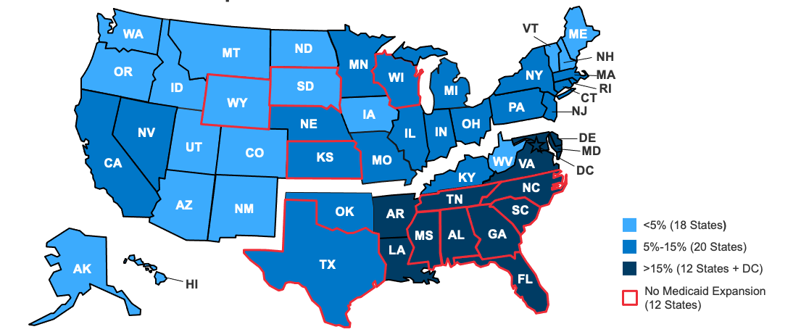
The Medicaid coverage gap disproportionately affects people of color.
Share of the Nonelderly Population that is Black by Medicaid Expansion Status
Race/Ethnicity of Adults in the Coverage Gap
2.2 Million Adults
NOTE: Totals may not sum to 100% due to rounding. Nonelderly includes individuals ages 0 to 64. Other includes Asian, American Indian Alaska Native, and Native Hawaiian and Other Pacific Islander people, along with people of multiple races. Hispanic people may be of any race but are categorized as Hispanic; other groups are all non-Hispanic.
SOURCES: KFF analysis of 2019 American Community Survey, 1-Year Estimates and KFF Status of State Medicaid Expansion Decision as of January 2022.

Slide 11
Health equity is a key priority identified by President Biden, CMS, and state Medicaid agencies.
Key Focus Areas in CMS Strategic Vision:
Coverage & Access
Equity
Innovation & Whole-Person Care
SOURCE: Chiquita Brooks-LaSure and Daniel Tsai, “A Strategic Vision for Medicaid And The Children’s Health Insurance Program (CHIP),” Health Affairs (November 2021): https://www.healthaffairs.org/do/10.1377/forefront.20211115.537685/full/

Slide 12
Recent federal policies could help address health disparities.
American Rescue Plan Act option to extend Medicaid postpartum coverage from 60 days to 12 months
American Rescue Plan Act fiscal incentive to adopt Medicaid expansion
Reversal of Trump Administration changes to public charge policies
Increased funding for Navigators and enrollment assistance
Enhanced racial/ethnic data collection and reporting
Proposed rule to improve retention of Medicaid coverage and remove barriers to CHIP coverage

Slide 13
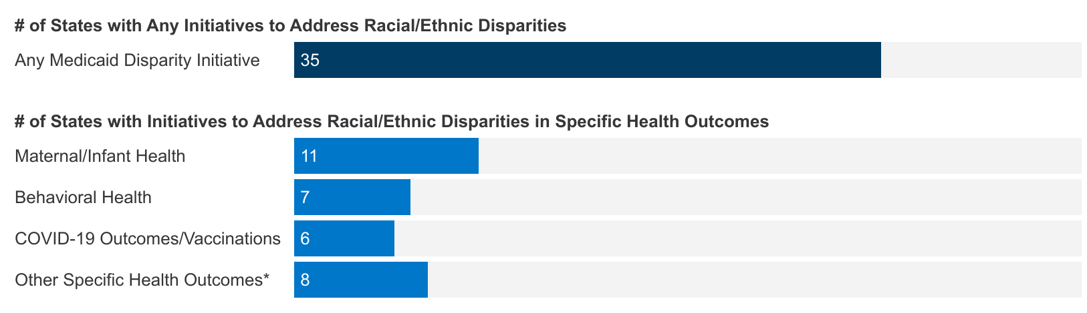
75% of states reported Medicaid initiatives to address racial/ethnic health disparities in FY 2021 or FY 2022.
NOTES: n = 47 responding states. *States reported targeting disparities in other specific health outcomes including diabetes, oral health, HIV, colorectal exams, sickle cell anemia, outcomes for people with complex health needs, and specific disease states associated with disparities.
SOURCE: KFF survey of Medicaid officials in 50 states and DC conducted by HMA, October 2021.

Slide 14
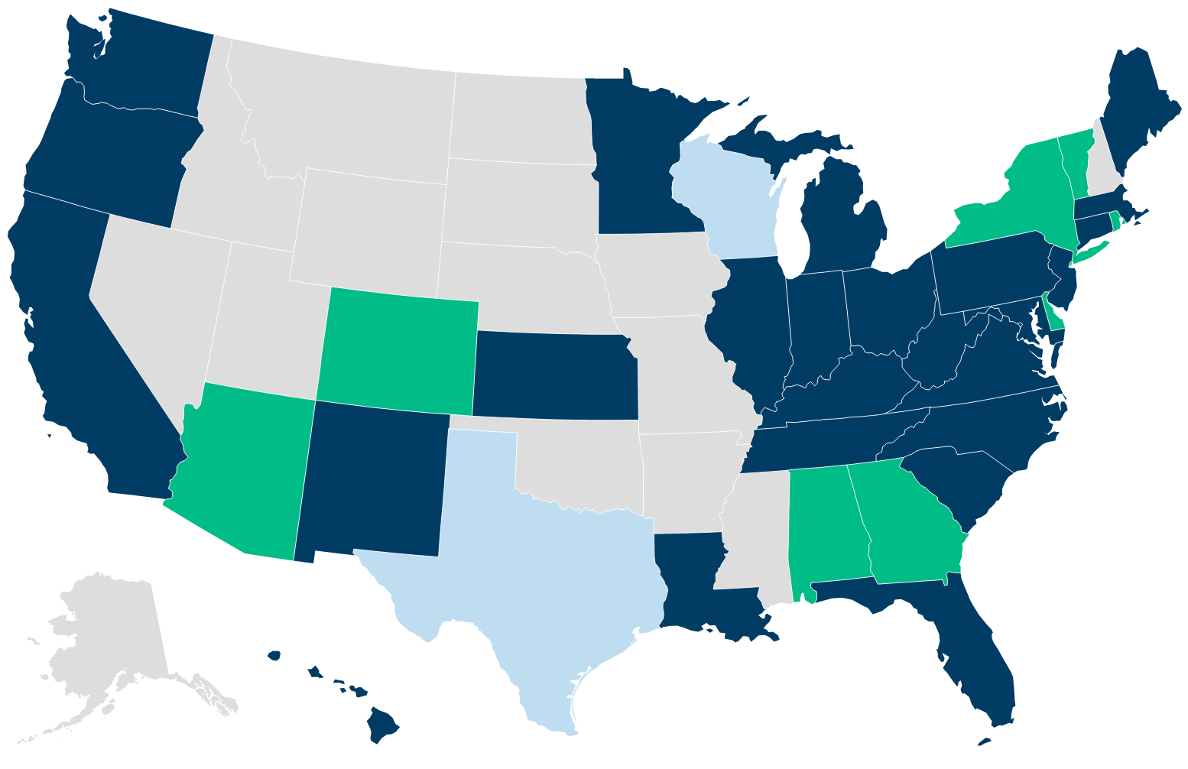
At least 36 states have taken steps to extend Medicaid postpartum coverage.
Approved & pending state actions as of 9/9/22, including:
12-month extension implemented (26 states including DC)
Planning to implement a 12-month extension (8 states)
Limited coverage extension proposed (2 states)*
NOTE: *These extensions would limit the postpartum coverage time period and/or eligible populations as compared to the 12-month postpartum extension option in the federal American Rescue Plan Act.
SOURCE: Medicaid Postpartum Coverage Extension Tracker, https://www.kff.org/medicaid/issue-brief/medicaid-postpartum-coverage-extension-tracker/

Slide 15
Across provisions in Section 1115 waiver requests, many states identify health equity as a key goal.
Themes in Pending Waivers Include:
Eligibility Expansions
Expanded postpartum coverage
Behavioral Health
Health Equity
Equity-related incentive payments for providers
Expanded eligibility for individuals w/ SUD or SMI
Social Determinants of Health
Provide services to incarcerated individuals pre-release
Housing & housing-related supports
Provide or connect individuals to other non-medical resources
Community-based behavioral health benefit expansions
Financial support to improve collection of race/ethnicity data

Slide 16
Looking ahead
Racial disparities in health and health care remain a persistent issue and will likely widen due to COVID-19
Medicaid can play an important role in addressing disparities as a major source of coverage for people of color and driver of innovation
Many initiatives currently underway in Medicaid are focused on advancing health equity
Continued expansions in Medicaid could further narrow disparities in coverage, which is tied to improvements in access to and use of care
Maintaining coverage of eligible people at the end of the public health emergency will be important for preventing growing gaps in coverage
Beyond coverage, addressing social and economic inequities will be key for improvements in health and health equity

