Slide 1
The Council of State Governments Medicaid Leadership Academy The District of Columbia’s Medicaid Coverage Expansion and Innovations September 15, 2022

Slide 2
The Department of Health Care Finance (DHCF) is a Cabinet Level Agency Responsible for the Administration of Medicaid and Other Public Health Insurance Programs in DC
VISION
All residents in the District of Columbia have the supports and services they need to be actively engaged in their health and to thrive.
MISSION
The Department of Health Care Finance works to improve health outcomes by providing access to comprehensive, cost-effective and quality healthcare services for residents of the District of Columbia.
VALUES
Accountability – Compassion – Empathy – Professionalism – Teamwork

Slide 3
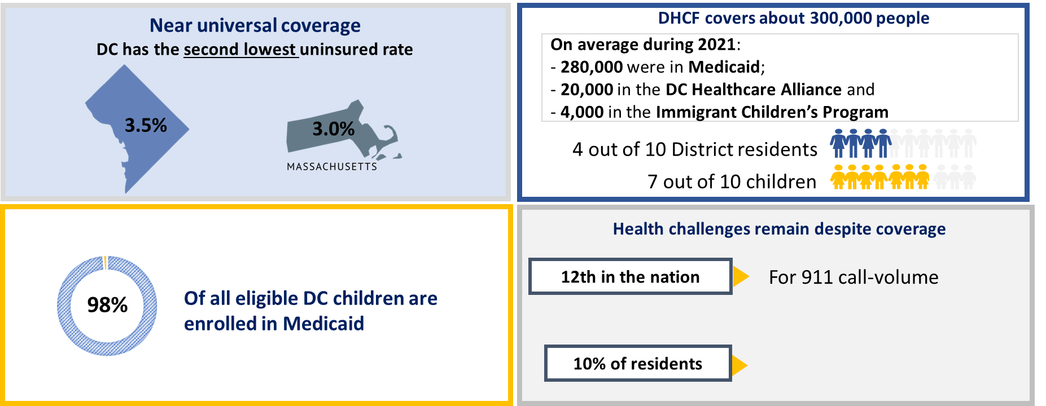
The District’s Public Health Insurance Programs
– Medicaid, CHIP, Alliance and Immigrant Children’s –
Cover More Than 40% of All District Residents
*Source: U.S. Census Bureau, 2019 American Community Survey 1-year estimates; DHCF Medicaid Management Information System (MMIS) data extracted in November 2021; Haley et al., “Progress in Children’s Coverage Continued to Stall Out in 2018,” Urban Institute, October 2020.

Slide 4
Most Low-Income Non-Elderly Adults are Medicaid-Eligible; Low-Income is 200% FPL Which is About $25k/Person or About $52k/Family of Four

Slide 5
Building on Delivery System Changes and Infrastructure Improvements, DHCF Announced Medicaid Reform Efforts in 2019
Coverage: Leveraged ACA opportunities to expand coverage to low-income adults
Knowledge Building/Performance: Created data warehouse to expand quality measurement and data analysis through the Medicaid Data Warehouse
IT: Developed technology infrastructure to allow for secure exchange of information across providers through HIE, EHR
Value: Increasing value-based payment approaches through pay for performance models in:
Managed care program
FQHC Alternative Payment Methodology
Other provider reimbursement / payment methods
Enhanced Care Coordination: Promoting access to the right care at the right time through health homes program
Strategic Priorities to Guide Reform Efforts
Building a health system that provides whole person care
Ensuring value and accountability
Strengthening internal operational infrastructure
Unwinding from the public heath emergency (PHE)

Slide 6
Moving to Whole Person Care Requires Better Integration of Services and Support to Providers
Integration of Services
Behavioral Health
Medicaid and Medicare
Supporting Providers
Enable information sharing through Health Information Exchange (HIE)
Make consent and social services information more accessible via HIE
Provide on the ground technical assistance

Slide 7
Part of Whole Person Care is Better Integrating Behavioral and Physical Health Services – Achieving This Requires Transformation of the District’s Behavioral Health Services and System
Key gaps in the Medicaid behavioral health service array
Disparate access to IMD services between Medicaid managed care and Fee for Service (FFS) programs
Complex and overlapping oversight make it harder to manage services in a holistic way that is integrated with other medical treatment
In DC, oversight of Medicaid behavioral health services is divided, with overlapping authority, primarily among Medicaid, Medicaid MCOs, and the behavioral health authority (Department of Behavioral Health or DBH)
The most intensive behavioral health services - mental health rehabilitative services (MHRS) and substance use disorder (SUD) - are carved out of managed care program and provided through FFS by the network of DBH-certified providers

Slide 8
Part of Whole Person Care is Better Integrating Behavioral and Physical Health Services – Achieving This Requires Transformation of the District’s Behavioral Health Services and System
Phase 1
Phase 2
Phase 3
October 2023
Incorporate a full continuum of behavioral health services into Medicaid managed care plans
FY24 and Beyond
Focus on additional opportunities to integrate physical and behavioral health for Medicaid beneficiaries.
January 2020
Implementation of the District’s Medicaid 1115 Behavioral Health Transformation Waiver
In FY21, work on the Waiver continues as the District is transitioning 8 of the 10 Waiver services to permanent State Plan authority, beginning January 1, 2022.
Five key areas of focus: Services, MCO Contractual Considerations, Provider and Beneficiary Support and Communications, Performance Management, and Provider Rates.

Slide 9
For dually eligible beneficiaries, the coordination of Medicaid and Medicare services is vital to whole-person
Approximately 39,000 of DHCF’s enrolled participants are dually eligible for both the Medicare program and Medicaid:
About two-thirds are “full duals” enrolled in both Medicare and full Medicaid coverage
About a third are “QMB only” enrolled in Medicare with some financial assistance paying Medicare cost-sharing from the Medicaid program
Both can benefit from improved coordination across Medicare and Medicaid
The District launched District Dual Choice in February with the goal to increase Medicare-Medicaid coordination
District Dual Choice is a highly integrated dual eligible special needs plan (HIDE SNP), that:
Offers enhanced care management for many who otherwise lack care management
Improves integration of benefits and reduce duplication of services between payers
Simplifies and streamlines navigation of services for beneficiaries and their families and caregivers

Slide 10
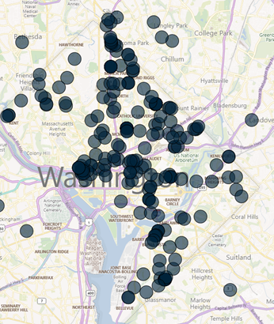
Health Information Exchange (HIE) Helps Providers Make the Connections Needed to Integrate and Coordinate Care More Seamlessly
Today Major Providers and Health Systems are Connected
DC HIE Connectivity: DC and beyond the borders of the District
8 Hospitals (all)
36 Long Term Care Facilities, including 15 Nursing Facilities;
20 Home Health Providers
8 Federally Qualified Health Centers (all)
30 Behavioral Health Providers
8 Community Based Organizations
DC HIE Use at a Glance (as of March 2022)
13,000+ approved users of the DC HIE
Patient Care Snapshot (Monthly Query)
1,156 users
Encounter Notification Services access
619 locations
Sharing Admit, discharge, transfer
~300 locations
Sharing Clinical care documentation
200+ locations

Slide 11
DC is Investing American Rescue Plan Funds to Increase Provider Participation in HIE for Behavioral Health and Other Home and Community Services (HCBS) Providers
Achieving whole person, integrated care requires all Medicaid providers participate in HIE
HCBS Promoting Interoperability (PI) Program Technical Assistance supports providers in connecting with the District’s HIE
The HCBS PI Program focuses on HCBS providers: inclusive of behavioral health, long-term care, disability services, and housing support services providers)
Providers are rewarded for meeting milestones to adopt and implement Certified EHR Technology (CEHRT) and/or approved case management systems and connect to the DC Health Information Exchange (DC HIE).
Program is modeled off the federal HITECH programs

Slide 12
The DC HIE Has Six Core Capabilities for Providers to Assist in Sharing Actionable Data to Inform the Patient’s Entire Care Team

Slide 13
SUD Consent Form
DHCF and DC HIE DHCF Partnered to Make Sharing Behavioral Health Information – Including Substance Use Disorder Data – Possible for Providers

Slide 14
Whole Person Care is More Than Just Health Care and the Community Resource Information Exchange (CoRIE) Initiative Connects Health Care Providers with Social Services
DHCF, CRISP DC, DC Primary Care Association, and DC Hospital Association are collectively known as ‘CoRIE Partners’
Committed to supporting and sustaining technical solutions and enabling coordinated whole person care across health, human, and social service providers in the District.
CoRIE is a Partnership
Screening for social risks and share dispositions
Lookup resources through a centralized community inventory (CRI)
Refer to appropriate community and support services
Together these 3 functionalities enable data sharing among health system stakeholders to address individuals’ social needs.
CoRIE is a set of 3 technical functionalities to address SDOH
Enables screening and referral information to be shared and displayed regardless of how it was collected
Ensures care partners can view the same information via DC HIE regardless of the vendor platform they use
CoRIE is a Vendor Agnostic Approach
Digitally connects care partner, including health and social service providers, through the DC HIE health data utility
Provides shared services across the region
Fosters a culture of shared responsibility for ensuring the availability and quality of actionable information
CoRIE is an Interoperable System within the DC HIE

Slide 15
Provider Technical Assistance is Necessary: Integrated Care DC is our “One Stop Shop” for Practice Transformation Support
Prepare providers for the behavioral health carve-in planned for FY23, as well as transition to value-based payment programs.
Competency-based practice transformation efforts directly align with DHCF’s strategic priorities to deliver whole person care, and address provider needs in several domains:
Clinical
Operational
Financial
Integrated Care Technical Assistance program
Community-wide learning opportunities (www.integratedcaredc.com)
Individualized practice coaching

Slide 16
Whole Person Care Can Be Achieved With Better Service Integration and Key Investments In and Support of Providers
Make coverage and benefits accessible
Build the infrastructure needed to share valuable data for providers / care teams
Offer technical assistance to the entire provider community to transform care and utilize new tools
Collaborate with other agency partners and stakeholders will be key
Keep at it!

Slide 17
Melisa Byrd | melisa.byrd@dc.gov
Learn more about DC Medicaid at: https://dhcf.dc.gov/
dchealthcarefinance
@DCHealthCareFin
DC-Department-of-Health-Care-Finance-DHCF

